Slide 1


CSB4202 - DATABASE MANAGEMENT SYSTEMS
B.Tech – III Semester
Dr. A. Antonidoss/Dr.Sathya Priya.S
Associate professor
School of Computing Sciences,
Department of Computer Science and Engineering

Slide 2
MODULE 3: DATA STORAGE AND QUERY PROCESSING
Record storage and Primary file organization- Secondary storage Devices- Operations on Files- Heap File- Sorted Files- Hashing Techniques – Index Structure for files –Different types of Indexes- B-Tree - B+Tree – Query Processing.

Slide 3
Storage Access
A database file is partitioned into fixed-length storage units called blocks. Blocks are units of both storage allocation and data transfer.
Database system seeks to minimize the number of block transfers between the disk and memory. We can reduce the number of disk accesses by keeping as many blocks as possible in main memory.
Buffer – portion of main memory available to store copies of disk blocks.
Buffer manager – subsystem responsible for allocating buffer space in main memory.

Slide 4
Buffer Manager
Programs call on the buffer manager when they need a block from disk.
If the block is already in the buffer, the requesting program is given the address of the block in main memory
If the block is not in the buffer,
the buffer manager allocates space in the buffer for the block, replacing (throwing out) some other block, if required, to make space for the new block.
The block that is thrown out is written back to disk only if it was modified since the most recent time that it was written to/fetched from the disk.
Once space is allocated in the buffer, the buffer manager reads the block from the disk to the buffer, and passes the address of the block in main memory to requester.

Slide 5
Buffer-Replacement Policies
Most operating systems replace the block least recently used (LRU strategy)
Idea behind LRU – use past pattern of block references as a predictor of future references
Queries have well-defined access patterns (such as sequential scans), and a database system can use the information in a user’s query to predict future references
LRU can be a bad strategy for certain access patterns involving repeated scans of data
Mixed strategy with hints on replacement strategy provided by the query optimizer is preferable

Slide 6
Buffer-Replacement Policies (Cont.)
Pinned block – memory block that is not allowed to be written back to disk.
Toss-immediate strategy – frees the space occupied by a block as soon as the final tuple of that block has been processed
Most recently used (MRU) strategy – system must pin the block currently being processed. After the final tuple of that block has been processed, the block is unpinned, and it becomes the most recently used block.
Buffer manager can use statistical information regarding the probability that a request will reference a particular relation
E.g., the data dictionary is frequently accessed. Heuristic: keep data-dictionary blocks in main memory buffer
Buffer managers also support forced output of blocks for the purpose of recovery

Slide 7
File Organization
The database is stored as a collection of files. Each file is a sequence of records. A record is a sequence of fields.
One approach:
assume record size is fixed
each file has records of one particular type only
different files are used for different relations
This case is easiest to implement; will consider variable length records later.

Slide 8
PLACING FILE RECORDS ON DISK
Records and Record Types
Data is usually stored in the form of records.
Each record consists of a collection of related data values or items, where each value is formed of one or more bytes and corresponds to a particular field of the record.
Records usually describe entities and their attributes.
A collection of field names and their corresponding data types constitutes a record type or record format definition
A data type, associated with each field, specifies the types of values a field can take.
The data type of a field is usually one of the standard data types used in programming.

Slide 9
PLACING FILE RECORDS ON DISK
Files, Fixed-length Records, and Variable-length Records
A file is a sequence of records.
If every record in the file has exactly the same size (in bytes), the file is said to be made up of fixed-length records.
If different records in the file have different sizes, the file is said to be made up of variable-length records.

Slide 10
PLACING FILE RECORDS ON DISK
A file may have variable-length records for several reasons:
The file records are of the same record type, but one or more of the fields are of varying size (variable-length fields).
The file records are of the same record type, but one or more of the fields may have multiple values for individual records; such a field is called a repeating field and a group of values for the field is often called a repeating group.
The file records are of the same record type, but one or more of the fields are optional; that is, they may have values for some but not all of the file records (optional fields).
The file contains records of different record types and hence of varying size (mixed file).

Slide 11
PLACING FILE RECORDS ON DISK
Files, Fixed-length Records, and Variable-length Records
The fixed-length record has the same fields, and field lengths are fixed, so the system can identify the starting byte position of each field relative to the starting position of the record.
This facilitates locating field values by programs that access such files.

Slide 12
PLACING FILE RECORDS ON DISK
Record Blocking and Spanned Versus Unspanned Records
The records of a file must be allocated to disk blocks because a block is the unit of data transfer between disk and memory.
When the block size is larger than the record size, each block will contain numerous records, although some files may have unusually large records that cannot fit in one block.
Suppose that the block size is B bytes for a file of fixed-length records of size R bytes, with B ≥R, we can fit bfr = |B/R |records per block, where the |(x)| (floor function) rounds down the number x to an integer. The value bfr is called the blocking factor for the file.

Slide 13
PLACING FILE RECORDS ON DISK
Record Blocking and Spanned Versus Unspanned Records
To utilize this unused space, we can store part of a record on one block and the rest on another.
A pointer at the end of the first block points to the block containing the remainder of the record in case it is not the next consecutive block on disk.
This organization is called spanned, because records can span more than one block.
Whenever a record is larger than a block, we must use a spanned organization. If records are not allowed to cross block boundaries, the organization is called unspanned.

Slide 14
PLACING FILE RECORDS ON DISK
Allocating File Blocks on Disk
There are several standard techniques for allocating the blocks of a file on disk.
In contiguous allocation the file blocks are allocated to consecutive disk blocks. This makes reading the whole file very fast using double buffering, but it makes expanding the file difficult.
In linked allocation each file block contains a pointer to the next file block. This makes it easy to expand the file but makes it slow to read the whole file.
Another possibility is to use indexed allocation, where one or more index blocks contain pointers to the actual file blocks. It is also common to use combinations of these techniques.

Slide 15
PLACING FILE RECORDS ON DISK
File Headers
A file header or file descriptor contains information about a file that is needed by the system programs that access the file records.
The header includes information to determine the disk addresses of the file blocks as well as to record format descriptions.

Slide 16
OPERATIONS ON FILES
Operations on files are usually grouped into retrieval operations and update operations.
The former do not change any data in the file, but only locate certain records so that their field values can be examined and processed.
The latter change the file by insertion or deletion of records or by modification of field values.
In either case, we may have to select one or more records for retrieval, deletion, or modification based on a selection condition (or filtering condition).

Slide 17
OPERATIONS ON FILES
Open: Prepares the file for reading or writing. Allocates appropriate buffers to hold file blocks from disk, and retrieves the file header. Sets the file pointer to the beginning of the file.
Reset: Sets the file pointer of an open file to the beginning of the file.
Find (or Locate): Searches for the first record that satisfies a search condition. Transfers the block containing that record into a main memory buffer .
Read (or Get): Copies the current record from the buffer to a program variable in the user program.

Slide 18
OPERATIONS ON FILES
FindNext: Searches for the next record in the file that satisfies the search condition. Transfers the block containing that record into a main memory buffer.
Delete: Deletes the current record and (eventually) updates the file on disk to reflect the deletion.
Modify: Modifies some field values for the current record and (eventually) updates the file on disk to reflect the modification.
Insert: Inserts a new record in the file by locating the block where the record is to be inserted, transferring that block into a main memory buffer, writing the record into the buffer, and (eventually) writing the buffer to disk to reflect the insertion.
Close: Completes the file access by releasing the buffers and performing any other needed cleanup operations.

Slide 19
OPERATIONS ON FILES
FindAll: Locates all the records in the file that satisfy a search condition.
Find (or Locate) n: Searches for the first record that satisfies a search condition and then continues to locate the next n - 1 records satisfying the same condition.
FindOrdered: Retrieves all the records in the file in some specified order.
Reorganize: Starts the reorganization process.

Slide 20
FILES OF UNORDERED RECORDS (HEAP FILES)
In this simplest and most basic type of organization, records are placed in the file in the order in which they are inserted, so new records are inserted at the end of the file.
Such an organization is called a heap or pile file.
Inserting a new record is very efficient: the last disk block of the file is copied into a buffer; the new record is added; and the block is then rewritten back to disk.

Slide 21
FILES OF UNORDERED RECORDS (HEAP FILES)
To delete a record, a program must first find its block, copy the block into a buffer, then delete the record from the buffer, and finally rewrite the block back to the disk.
This leaves unused space in the disk block.
During reorganization, the file blocks are accessed consecutively, and records are packed by removing deleted records.
To read all records in order of the values of some field, we create a sorted copy of the file.

Slide 22
FILES OF ORDERED RECORDS (SORTED FILES)
We can physically order the records of a file on disk based on the values of one of their fields-called the ordering field.
This leads to an ordered or sequential file.
If the ordering field is also a key field of the file-a field guaranteed to have a unique value in each record-then the field is called the ordering key for the file.
Ordered records have some advantages over unordered files.

Slide 23
FILES OF ORDERED RECORDS (SORTED FILES)
First, reading the records in order of the ordering key values becomes extremely efficient, because no sorting is required.
Second, finding the next record from the current one in order of the ordering key usually requires no additional block accesses, because the next record is in the same block as the current one (unless the current record is the last one in the block).
Third, using a search condition based on the value of an ordering key field results in faster access when the binary search technique is used, which constitutes an improvement over linear searches, although it is not often used for disk files.

Slide 24
Organization of Records in Files
Heap – a record can be placed anywhere in the file where there is space
Sequential – store records in sequential order, based on the value of the search key of each record
Hashing – a hash function computed on some attribute of each record; the result specifies in which block of the file the record should be placed
Records of each relation may be stored in a separate file. In a clustering file organization records of several different relations can be stored in the same file
Motivation: store related records on the same block to minimize I/O

Slide 25
Data Dictionary Storage
Data dictionary (also called system catalog) stores metadata: that is, data about data, such as
Information about relations
names of relations
names and types of attributes of each relation
names and definitions of views
integrity constraints
User and accounting information, including passwords
Statistical and descriptive data
number of tuples in each relation
Physical file organization information
How relation is stored (sequential/hash/…)
Physical location of relation
operating system file name or
disk addresses of blocks containing records of the relation
Information about indices.

Slide 26
Data Dictionary Storage (Cont.)
Catalog structure: can use either
specialized data structures designed for efficient access
a set of relations, with existing system features used to ensure efficient access
The latter alternative is usually preferred
A possible catalog representation:
Relation-metadata = (relation-name, number-of-attributes, storage-organization, location) Attribute-metadata = (attribute-name, relation-name, domain-type, position, length)
User-metadata = (user-name, encrypted-password, group)
Index-metadata = (index-name, relation-name, index-type, index-attributes)
View-metadata = (view-name, definition)

Slide 27
Hashing Technique
Another type of primary file organization is based on hashing, which provides very fast access to records on certain search conditions.
This organization is usually called a hash file.
The search condition must be an equality condition on a single field, called the hash field of the file.
In most cases, the hash field is also a key field of the file, in which case it is called the hash key.
The idea behind hashing is to provide a function h, called a hash function or randomizing function, which is applied to the hash field value of a record and yields the address of the disk block in which the record is stored.

Slide 28
Static Hashing
A bucket is a unit of storage containing one or more records (a bucket is typically a disk block).
In a hash file organization we obtain the bucket of a record directly from its search-key value using a hash function.
Hash function h is a function from the set of all search-key values K to the set of all bucket addresses B.
Hash function is used to locate records for access, insertion as well as deletion.
Records with different search-key values may be mapped to the same bucket; thus entire bucket has to be searched sequentially to locate a record.

Slide 29
Example of Hash File Organization (Cont.)
Hash file organization of account file, using branch-name as key (See figure in next slide.)
There are 10 buckets,
The binary representation of the ith character is assumed to be the integer i.
The hash function returns the sum of the binary representations of the characters modulo 10
E.g. h(Perryridge) = 5 h(Round Hill) = 3 h(Brighton) = 3

Slide 30
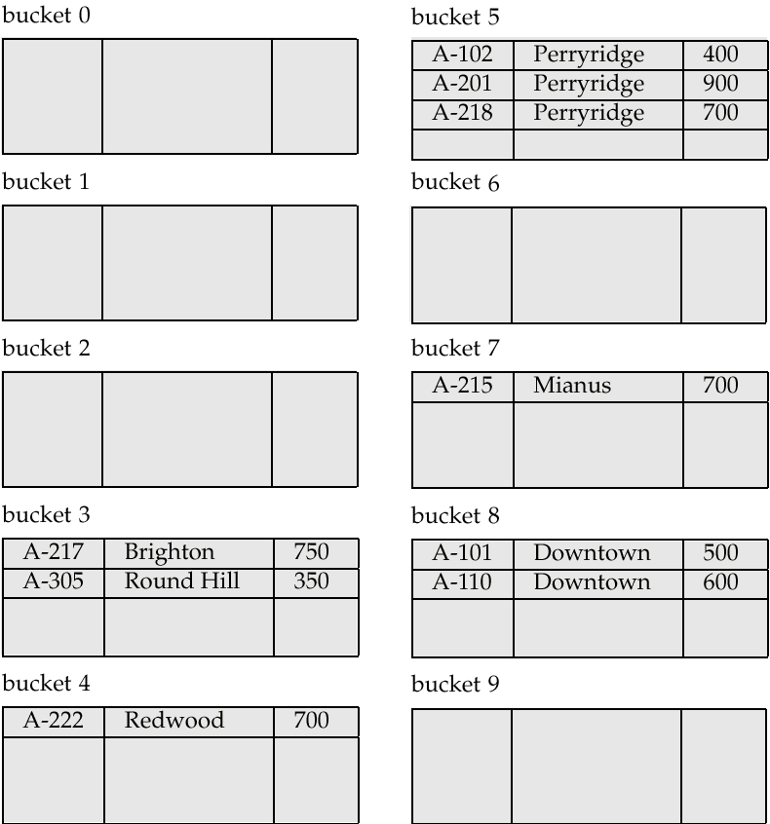
Example of Hash File Organization
Hash file organization of account file, using branch-name as key.

Slide 31
Hash Functions
Worst hash function maps all search-key values to the same bucket; this makes access time proportional to the number of search-key values in the file.
An ideal hash function is uniform, i.e., each bucket is assigned the same number of search-key values from the set of all possible values.
Ideal hash function is random, so each bucket will have the same number of records assigned to it irrespective of the actual distribution of search-key values in the file.
Typical hash functions perform computation on the internal binary representation of the search-key.
For example, for a string search-key, the binary representations of all the characters in the string could be added and the sum modulo the number of buckets could be returned. .

Slide 32
Handling of Bucket Overflows
Bucket overflow can occur because of
Insufficient buckets
Skew in distribution of records. This can occur due to two reasons:
multiple records have same search-key value
chosen hash function produces non-uniform distribution of key values
Although the probability of bucket overflow can be reduced, it cannot be eliminated; it is handled by using overflow buckets.

Slide 33
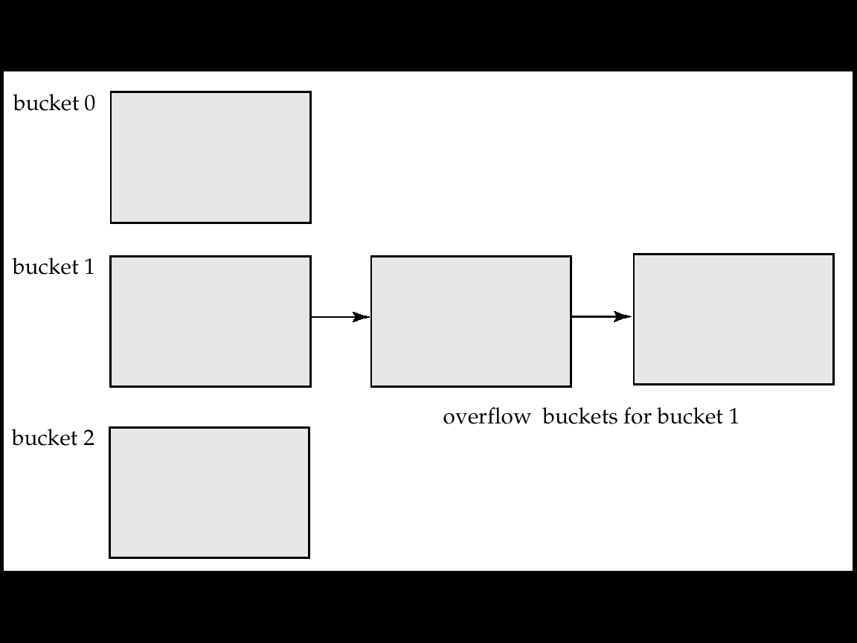
Handling of Bucket Overflows (Cont.)
Overflow chaining – the overflow buckets of a given bucket are chained together in a linked list.
Above scheme is called closed hashing.
An alternative, called open hashing, which does not use overflow buckets, is not suitable for database applications.

Slide 34
Hash Indices
Hashing can be used not only for file organization, but also for index-structure creation.
A hash index organizes the search keys, with their associated record pointers, into a hash file structure.
Strictly speaking, hash indices are always secondary indices
if the file itself is organized using hashing, a separate primary hash index on it using the same search-key is unnecessary.
However, we use the term hash index to refer to both secondary index structures and hash organized files.

Slide 35
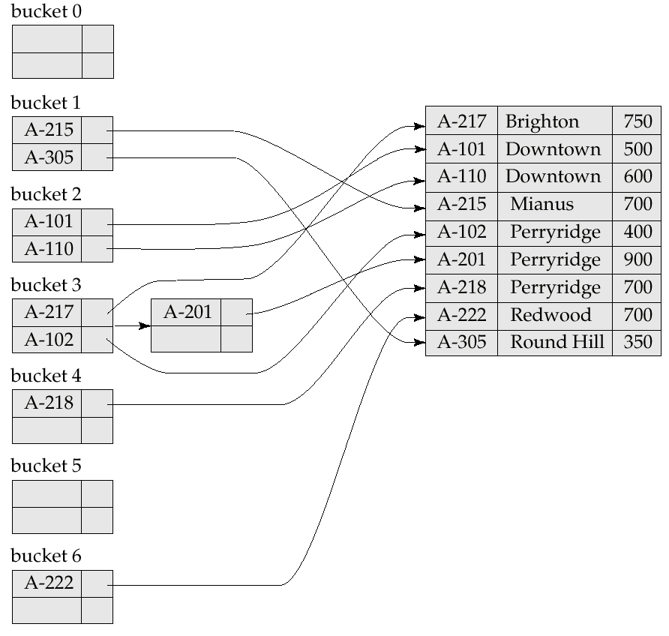
Example of Hash Index

Slide 36
Deficiencies of Static Hashing
In static hashing, function h maps search-key values to a fixed set of B of bucket addresses.
Databases grow with time. If initial number of buckets is too small, performance will degrade due to too much overflows.
If file size at some point in the future is anticipated and number of buckets allocated accordingly, significant amount of space will be wasted initially.
If database shrinks, again space will be wasted.
One option is periodic re-organization of the file with a new hash function, but it is very expensive.
These problems can be avoided by using techniques that allow the number of buckets to be modified dynamically.

Slide 37
Dynamic Hashing
Good for database that grows and shrinks in size
Allows the hash function to be modified dynamically
Extendable hashing – one form of dynamic hashing
Hash function generates values over a large range — typically b-bit integers, with b = 32.
At any time use only a prefix of the hash function to index into a table of bucket addresses.
Let the length of the prefix be i bits, 0 ≤ i ≤ 32.
Bucket address table size = 2^{i.} Initially i = 0
Value of i grows and shrinks as the size of the database grows and shrinks.
Multiple entries in the bucket address table may point to a bucket.
Thus, actual number of buckets is < 2^{i}
The number of buckets also changes dynamically due to coalescing and splitting of buckets.

Slide 38
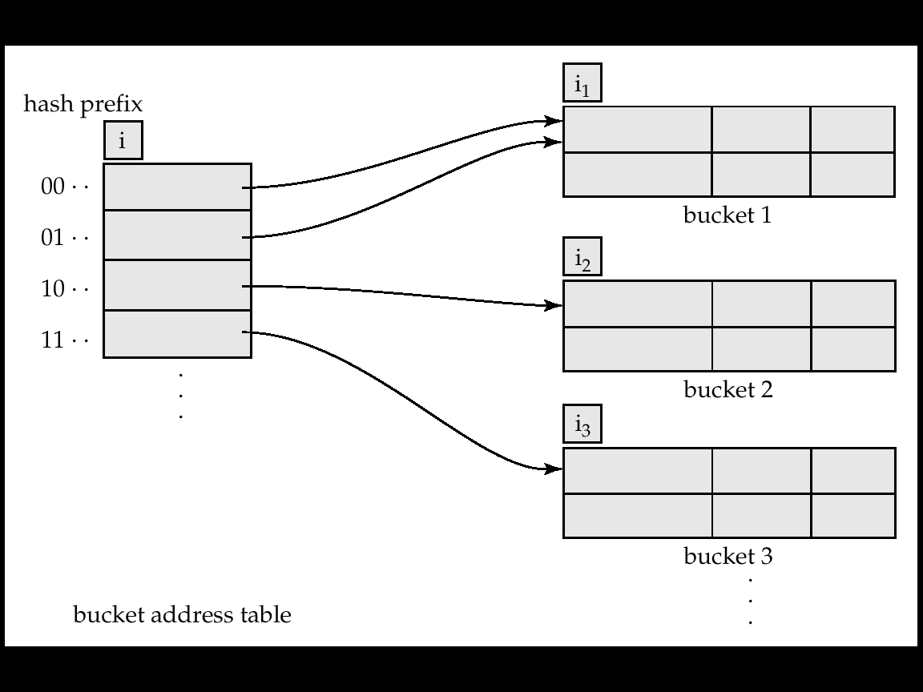
General Extendable Hash Structure
In this structure, i₂ = i₃ = i, whereas i₁ = i – 1 (see next slide for details)

Slide 39
Use of Extendable Hash Structure
Each bucket j stores a value i_{j}; all the entries that point to the same bucket have the same values on the first i_{j} bits.
To locate the bucket containing search-key K_{j}:
1. Compute h(K_{j}) = X
2. Use the first i high order bits of X as a displacement into bucket address table, and follow the pointer to appropriate bucket
To insert a record with search-key value K_{j}
follow same procedure as look-up and locate the bucket, say j.
If there is room in the bucket j insert record in the bucket.
Else the bucket must be split and insertion re-attempted (next slide.)
Overflow buckets used instead in some cases (will see shortly)

Slide 40
Updates in Extendable Hash Structure
To split a bucket j when inserting record with search-key value K_{j}:
If i > i_{j} (more than one pointer to bucket j)
allocate a new bucket z, and set i_{j} and i_{z} to the old i_{j} -+ 1.
make the second half of the bucket address table entries pointing to j to point to z
remove and reinsert each record in bucket j.
recompute new bucket for K_{j} and insert record in the bucket (further splitting is required if the bucket is still full)
If i = i_{j} (only one pointer to bucket j)
increment i and double the size of the bucket address table.
replace each entry in the table by two entries that point to the same bucket.
recompute new bucket address table entry for K_{j} Now i > i_{j} so use the first case above.

Slide 41
Updates in Extendable Hash Structure (Cont.)
When inserting a value, if the bucket is full after several splits (that is, i reaches some limit b) create an overflow bucket instead of splitting bucket entry table further.
To delete a key value,
locate it in its bucket and remove it.
The bucket itself can be removed if it becomes empty (with appropriate updates to the bucket address table).
Coalescing of buckets can be done (can coalesce only with a “buddy” bucket having same value of i_{j} and same i_{j} –1 prefix, if it is present)
Decreasing bucket address table size is also possible
Note: decreasing bucket address table size is an expensive operation and should be done only if number of buckets becomes much smaller than the size of the table

Slide 42
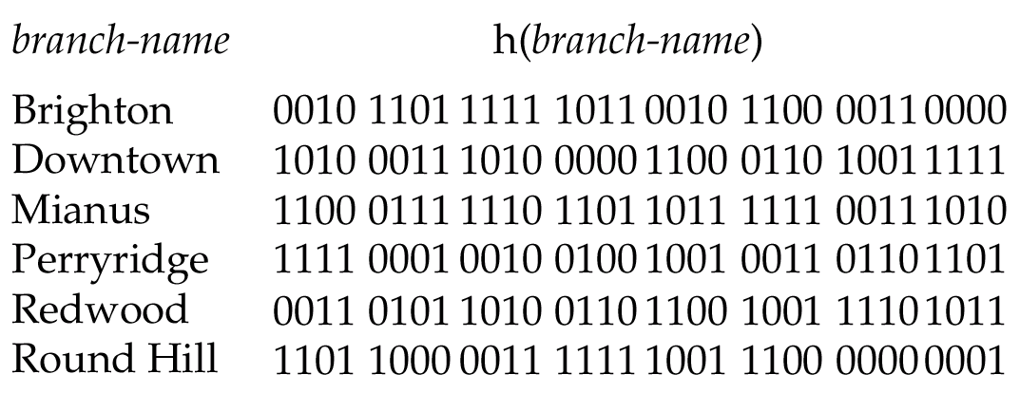
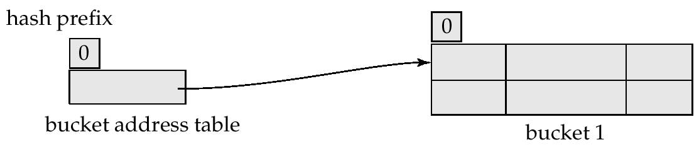
Use of Extendable Hash Structure: Example
Initial Hash structure, bucket size = 2

Slide 43
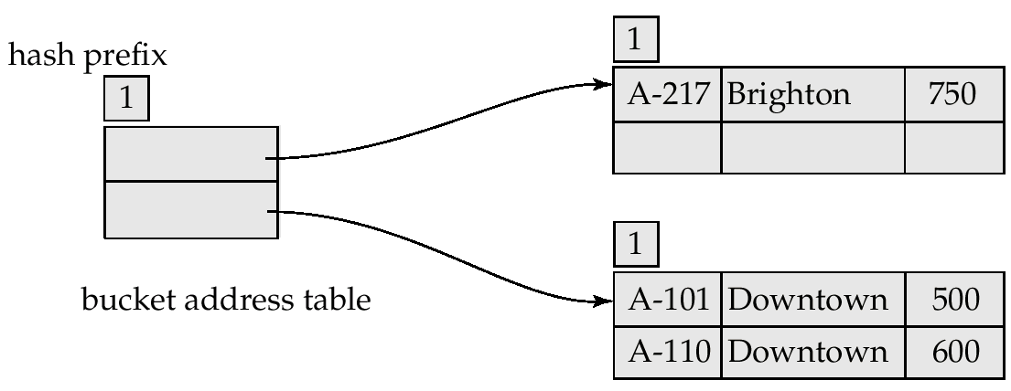
Example (Cont.)
Hash structure after insertion of one Brighton and two Downtown records

Slide 44
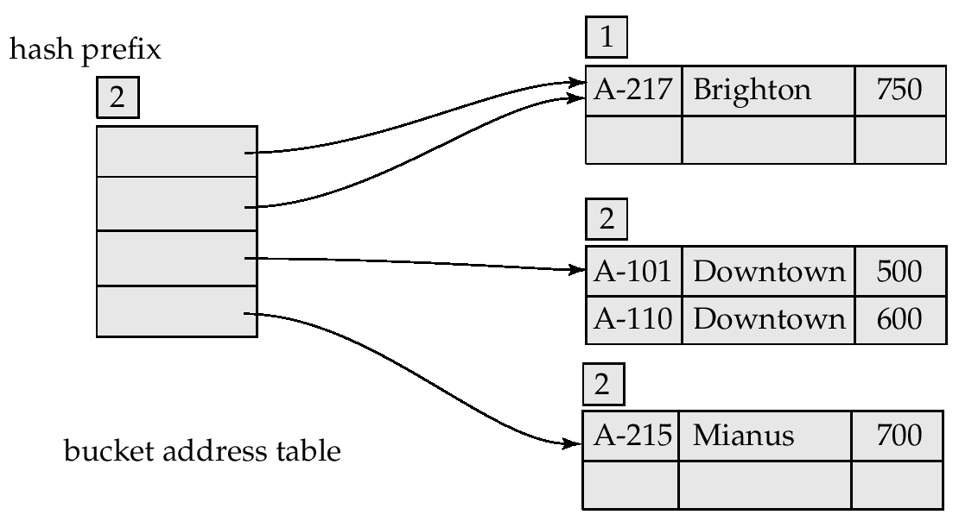
Example (Cont.)
Hash structure after insertion of Mianus record

Slide 45
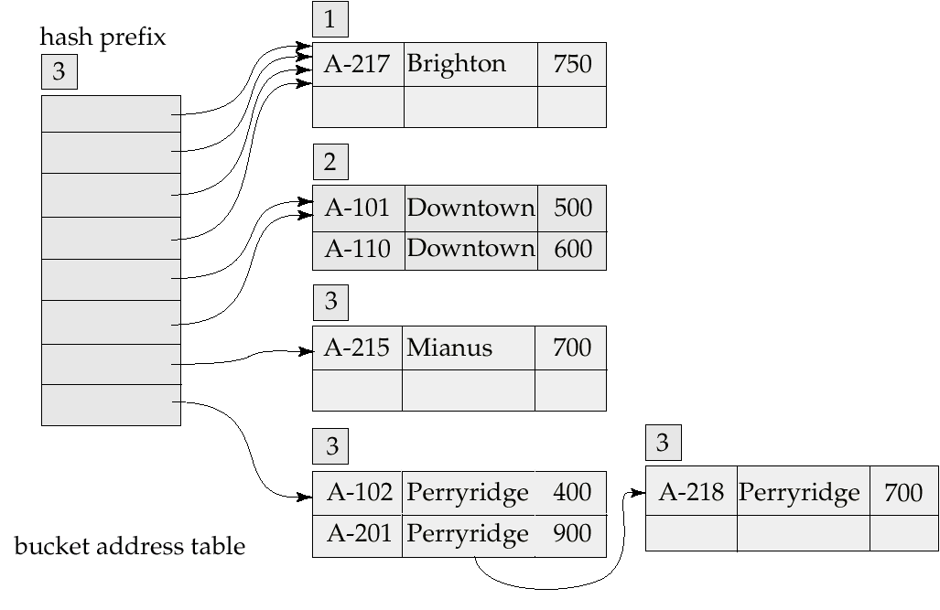
Example (Cont.)
Hash structure after insertion of three Perryridge records

Slide 46
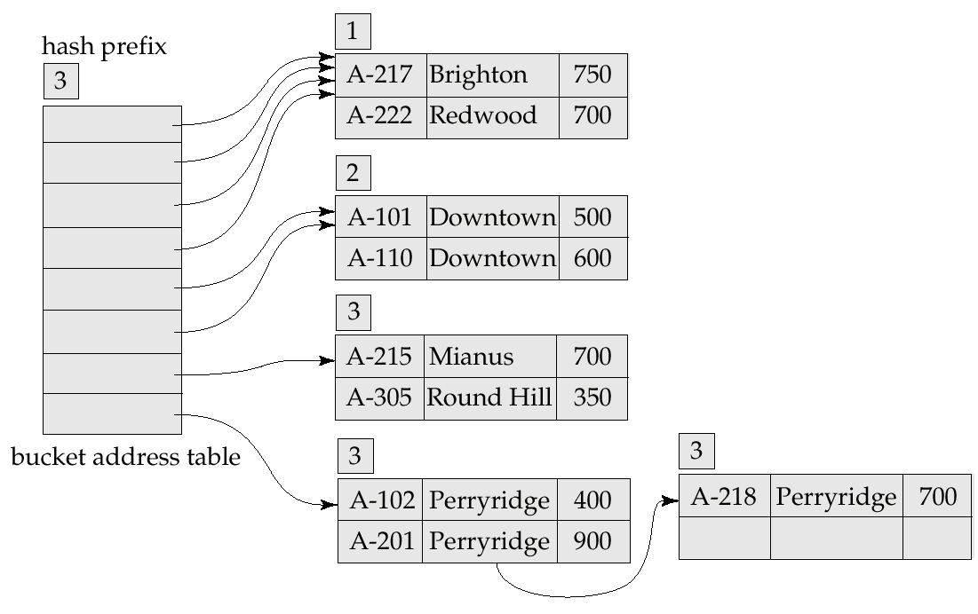
Example (Cont.)
Hash structure after insertion of Redwood and Round Hill records

Slide 47
Extendable Hashing vs. Other Schemes
Benefits of extendable hashing:
Hash performance does not degrade with growth of file
Minimal space overhead
Disadvantages of extendable hashing
Extra level of indirection to find desired record
Bucket address table may itself become very big (larger than memory)
Need a tree structure to locate desired record in the structure!
Changing size of bucket address table is an expensive operation
Linear hashing is an alternative mechanism which avoids these disadvantages at the possible cost of more bucket overflows

Slide 48
Comparison of Ordered Indexing and Hashing
Cost of periodic re-organization
Relative frequency of insertions and deletions
Is it desirable to optimize average access time at the expense of worst-case access time?
Expected type of queries:
Hashing is generally better at retrieving records having a specified value of the key.
If range queries are common, ordered indices are to be preferred

